Slide 1
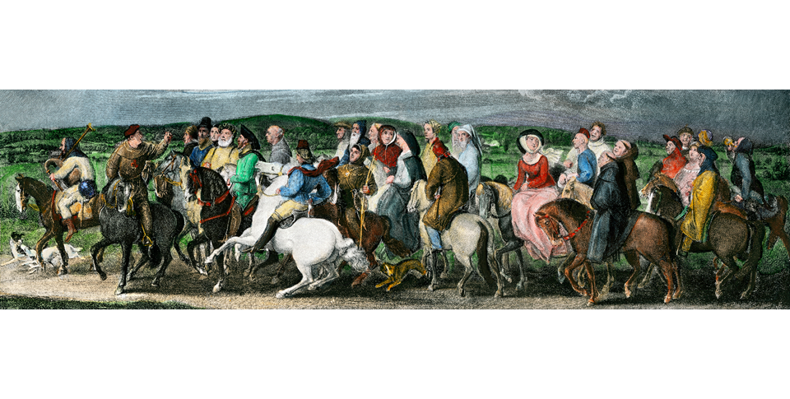
Medieval Christian Europe (330–1450)
Lesson 3 The Medieval Christian Church

Slide 2
Medieval Christian Europe (330–1450)
Lesson 3 The Medieval Christian Church
Learning Objectives
Explain how the Christian Church shaped medieval life.
Understand monastic life and the influence of medieval monks and nuns.
Analyze how the power of the Church grew during the Middle Ages and how reformers worked for change in the Church.
Describe the situation of Jews in medieval Europe.
Analyze how Christianity in the Byzantine empire differed from Christianity in the West.

Slide 3
The Church Shapes Everyday Life
The Spread of Christianity
Christianity is spread during the Middle Ages by the use of missionaries, wandering priest used to convert people in the faith like the Germanic Tribes who were coming in. by the late Middle Ages Christianity is going to be the unifying force for Western Europe
The Parish Priest
Only contact with the Church
Will perform sacred rites and possibly teach
Will also collect the tithe, 1/10 of your income
The Village Church
Social life will center on the Church because of ceremonies such as baptism and marriage
Later on people will go on pilgrimages to visit relics of saints at these Churches

Slide 4
The Church Shapes Everyday Life
The Rise of Cathedrals
Built by wealthier priests called bishops these are beautiful larger churches
Women and the Church
Tried to protect women, set up minimum age for marriage.
Double standard, punished women twice as much for the same offense by man

Slide 5
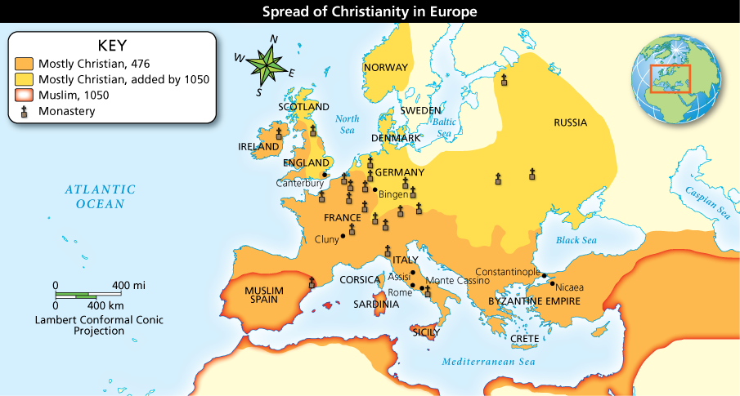
The Church Shapes Everyday Life
Analyze Maps Name three areas of Europe that became Christian between 476 and 1050.

Slide 6
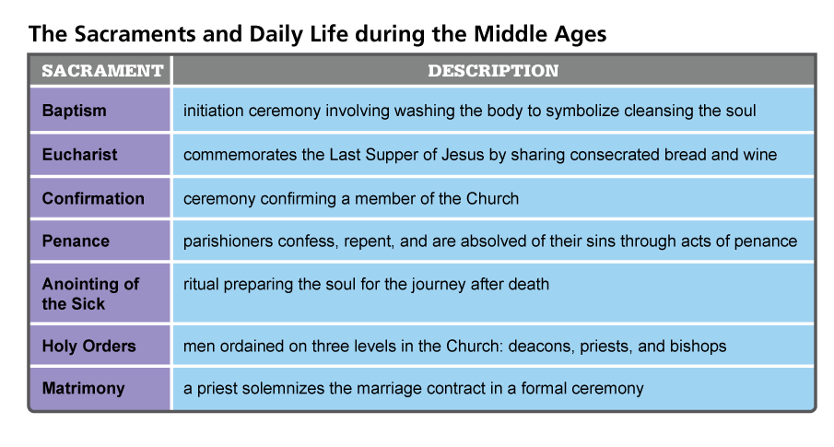
The Church Shapes Everyday Life
Analyze Charts How did the sacraments affect daily life in medieval Europe?

Slide 7
The Church Shapes Everyday Life
Pilgrims, like these characters in an illustration from Chaucer's Canterbury Tales, were a common sight on the roads of medieval Europe.

Slide 8
Life in Monasteries and Convents
The Benedictine Rule
Vow of Obedience, Vow of Poverty, Vow of Purity
Belief in manual labor
A Life of Service
Offered basic social services like taking care of the sick, setting up school for children, lodging for the night. Also as missionaries
Centers of Learning
Monks and nuns are going to copy down Ancient Greek and Roman works, keeping knowledge around.
Convents Offer Opportunities for Women
A place where women could learn more than she could outside
Hildegard of Bingen invented Gregorian Chant among other things
Later on power to hear confession and other things taken away

Slide 9
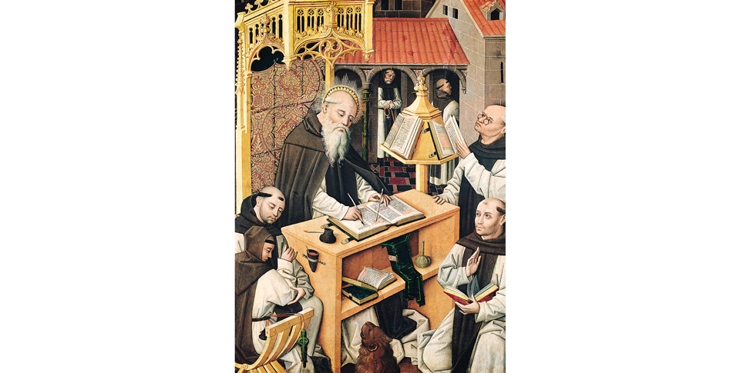
Life in Monasteries and Convents
This Spanish painting from the 1500s shows a scriptorium, a room in a monastery used for writing.

Slide 10
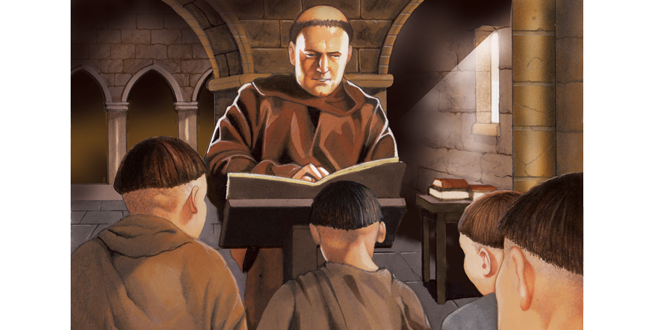
Life in Monasteries and Convents
Medieval monasteries were centers of religious, educational, and community life in medieval Europe.

Slide 11
The Growth of Church Power
A Spiritual and Worldly Empire
The Roman Catholic Church is going to grow more powerful during the Middle Ages
The Pope is going to control parts of Italy known as the Papal States
Bishops and other Noble clergy will hold estates and armies to help maintain power
Church Law and Authority
Church law is called Canon Law and will set up the rules governing life
Excommunication was the worst punishment they had, it cut you off of the sacraments
The threat of an interdict was how they kept nobles under control

Slide 12
The Growth of Church Power
Working for Peace
Tries to limit warfare, is successful
The Legacy of Judeo-Christian Teachings
Combining Jewish and Christian Ideals
Emphasized the individual and the importance social responsibility

Slide 13
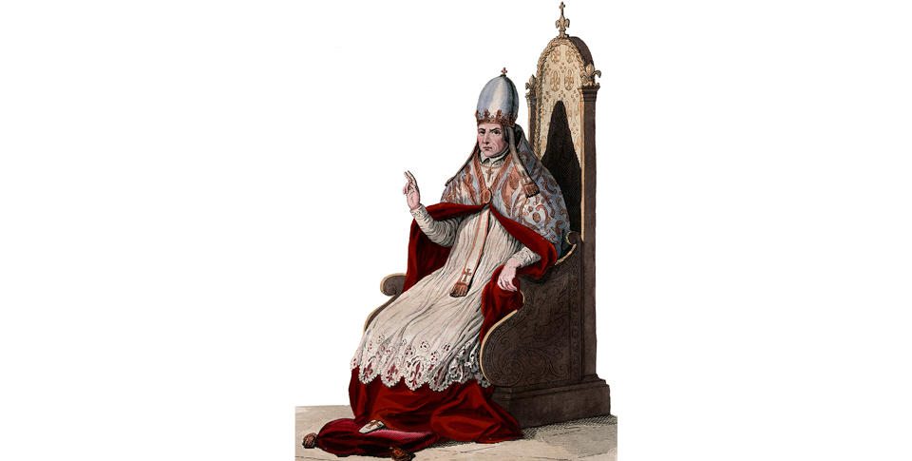
The Growth of Church Power
This illustration of Pope Sylvester II, who reigned from 999 to 1003, shows the power and pomp of medieval European popes.

Slide 14
The Church Faces Calls to Reform
Analyze Charts Which criticism do you think common people felt most strongly? Why?

Slide 15
The Church Faces Calls to Reform
Reform Movements
Early 900’s Abbot Berno revives the Benedictine rules in his monastery of Cluny
Does not allow nobles to interfere with monastic affairs and comes under the protection of the Pope. Over the next 200 years other monasteries are going to do the same
Pope Gregory VII, a former monk, is going to extend these reforms to all of the Church. He is going to stop the selling of Church offices, not allow priest to marry, and insist that the Church, not king and nobles, choose Church officials. This will lead to problems with Germany

Slide 16
The Church Faces Calls to Reform
Preaching Orders
The Franciscans- A group of friars who preach to the poor, founded by St. Francis of Assisi a wealthy Italian who gives up his wealth to preach and do good works
The Dominicans- Founded by St. Dominic, their job is to teach Church doctrine and stamp out heresy

Slide 17
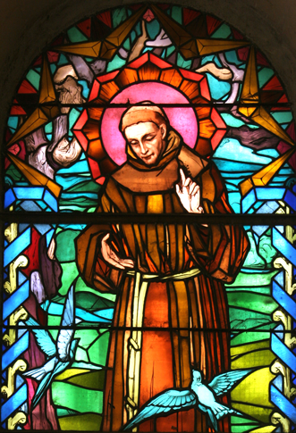
The Church Faces Calls to Reform
Francis of Assisi, shown in this stained glass window, abandoned a life of wealth and privilege to devote himself to preaching and performing good works.

Slide 18
Jewish Communities in Medieval Europe
Communities in Spain and Northern Europe
Jewish communities thrive in Spain. Muslims were tolerant of their religion and the Jews served as officials for the Muslims
They were also tolerated in Northern Europe by Christian Kings even though they were taxed heavily
Persecution
The Church and local rulers would not let Jews practice many trades and the Church would not allow them to own land.
Christian people blamed Jews for economic hardship, famine, or disease.
In some places they had to wear identifying clothing or live in certain sections of the city called ghettos.

Slide 19
Jewish Communities in Medieval Europe
This is the start of Anti-Semitism in Europe
Because Jews are barred from so many professions they become money lenders because the Church forbids Christians from that trade. That will bring more resentment from debt heavy nobles
Between 1096-1450 Jews are going to be expelled from England, France, Germany, Austria, Italy, and Hungary. They are going to Eastern Europe and have times of tolerance and persecution as well.

Slide 20
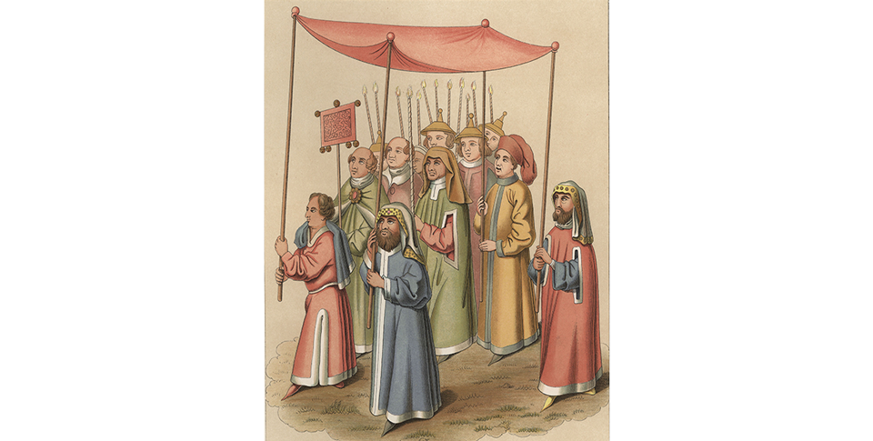
Jewish Communities in Medieval Europe
A Jewish religious procession winds its way through a medieval European street in the 1400s.

Slide 21
The Christian Church Is Divided
Differences East and West
In the Byz. Empire the Emperor chooses the highest Church official, not the priests like in Rome.
Byz. Christians reject claim that the Pope has authority on all Christians
Roman priest cannot marry, Byz priest can
Greek was the language of Byz. Church, Latin for Catholics
Both sides agree that Easter is the most holy holiday but Byz. do not emphasize Christmas as much
Dispute Over Icons
Many Byz. Christians prayed to images of Mary, Jesus, and the Saints. A Byz. Emperor outlaws the use of Icons, saying it violates commandment of not worshiping graven images. The Pope excommunicates the Byz. Emperor. Later on another emperor will restore the Icons, but the damage is already done.

Slide 22
The Christian Church Is Divided
The Great Schism
By 1054 all of these arguments split the Eastern and Western Christianity
Byz. Church is now the Eastern Orthodox Church, west is Roman Catholic Church
Eastern have a Patriarch, West have a Pope and both will excommunicate each other after any controversies
Just like the Roman Church the Eastern Church is going to serve the same role in unifying the country. People will use the same calendar, follow the same traditions.

Slide 23
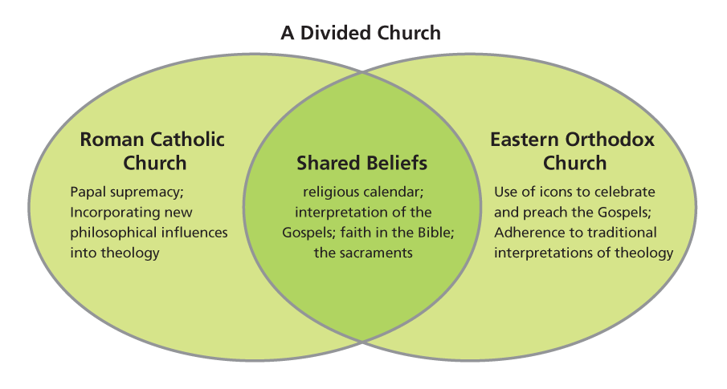
The Christian Church Is Divided
Analyze Charts Which church branch used icons? Which professed papal supremacy?

Slide 24
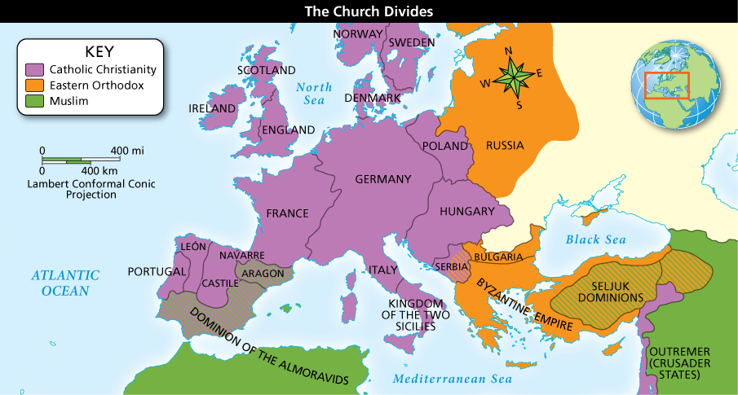
The Christian Church Is Divided
Analyze Maps What part of Europe was influenced by both the Roman Catholic and Eastern Orthodox Churches?

